Slide 1
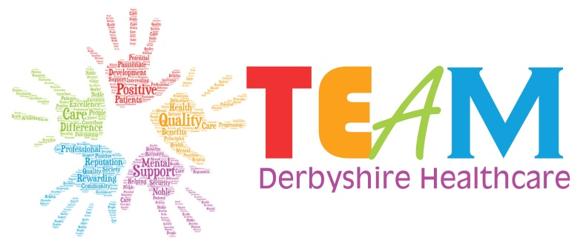
Unconscious Bias in Safeguarding Adults Training
Notes:
09.30 Brief overview of my experience and roles/employment.
Reason for this training: “Core Skills Training Framework (England). Statutory/Mandatory Subject Guide Version: CSTF (England) v1.0 April 2020.
For NHS Trusts in England
Next slide 2. MCA in practice

Slide 2
Categories of Unconscious Bias
Behaviour showing favouritism toward one gender over another. Most often, the act of favouring men and women. When we use the term gender, we mean socially constructed expectations and roles for women and men
Gender Bias
Colour/Culture Bias
Ageism Bias
Name Bias
Preference of one culture over another. The tendency to judge outside world through a narrow view based on own culture. Can be viewed as discrimination
To stereotype and/or discriminate against individuals or groups on the basis of their age. It may be casual or systematic.
Refers to a form of prejudice where an individual is negatively discriminated against on accounts of their name.
Confirmation Bias
Conformity Bias
Halo Effect
Beauty Bias
To search for information in a way that confirms our prior beliefs and views. A series of psychological experiments in the 1960s suggested that people are biased toward confirming their existing beliefs.
May occur when we face peer pressure or are trying to fit into particular professional or social environments. The impairment of individual decision-making known as “groupthink”
The halo effect is a type of cognitive bias in which our overall impression of a person influences how we feel and think about their character. Can include what school, or Uni they attended.
Beauty bias concerns the favourable treatment that individuals receive when they are deemed more attractive, regardless of whether this happens consciously or unconsciously
Attribution Bias
Affinity Bias
This bias occurs when you assess two or more similar things and compare them with one another, rather than looking at each based on their own merits. Can create harsh judgement and too high standards
Contrast Effect
Hair Colour Bias
We attribute our successes to our skill, but our failures to randomness or acts of others
Is the unconscious tendency to get along with others who are like us. It requires more effort to bridge differences when diversity is present.
Linked to Appearance Bias- 90% of population has dark hair, but blond has connotations. And differing attitudes towards redheads

